Slide 1

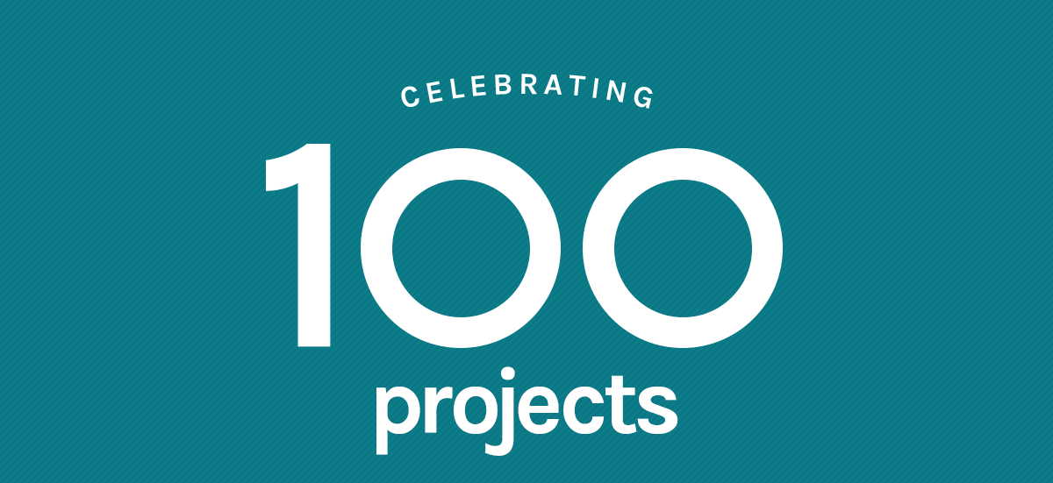

People Powered Research

Slide 2
Bringing Citizen Science
into Science Courses
Dr. Laura Trouille; VP of Citizen Science
Zooniverse, The Adler Planetarium, Northwestern Univ.

Slide 3
What is Citizen Science?

Slide 4
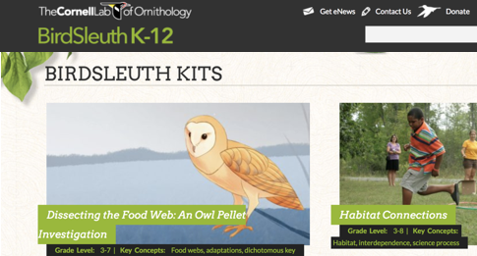
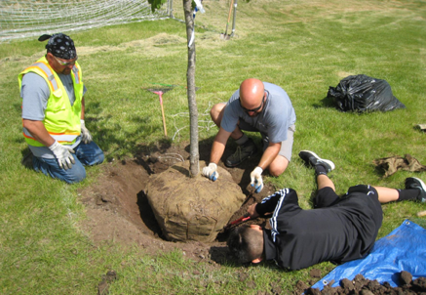
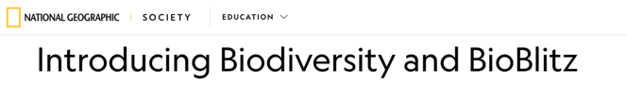

Crowdsourcing Environmental Action Projects

Slide 5
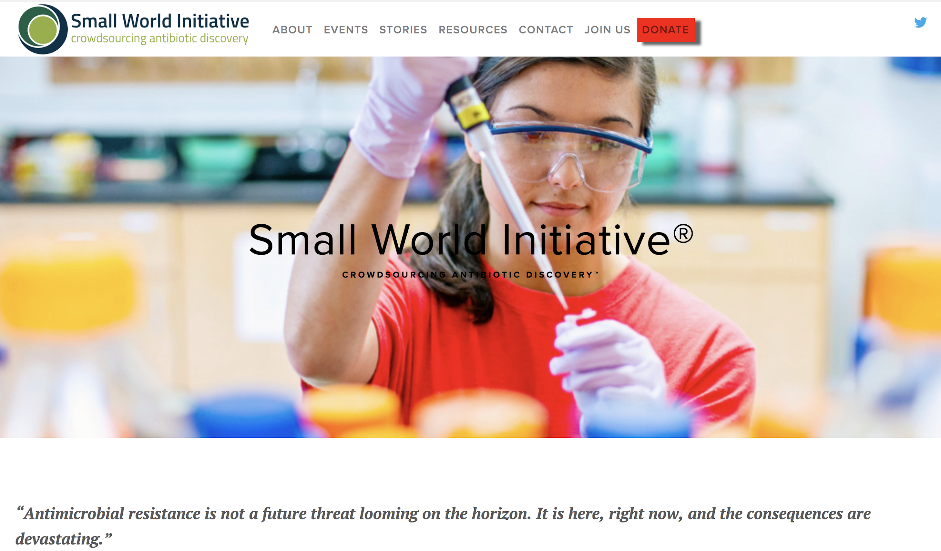
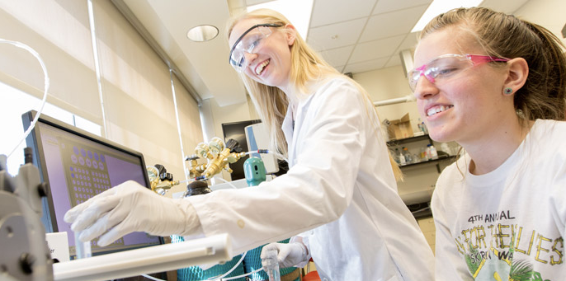
Crowdsourcing Lab-based Research
CASPiE
Heemstra et al. (2017)
cns.utexas.edu/fri
seaphages.org, gep.wustl.edu, & SmallWorldInitiative.org

Slide 6
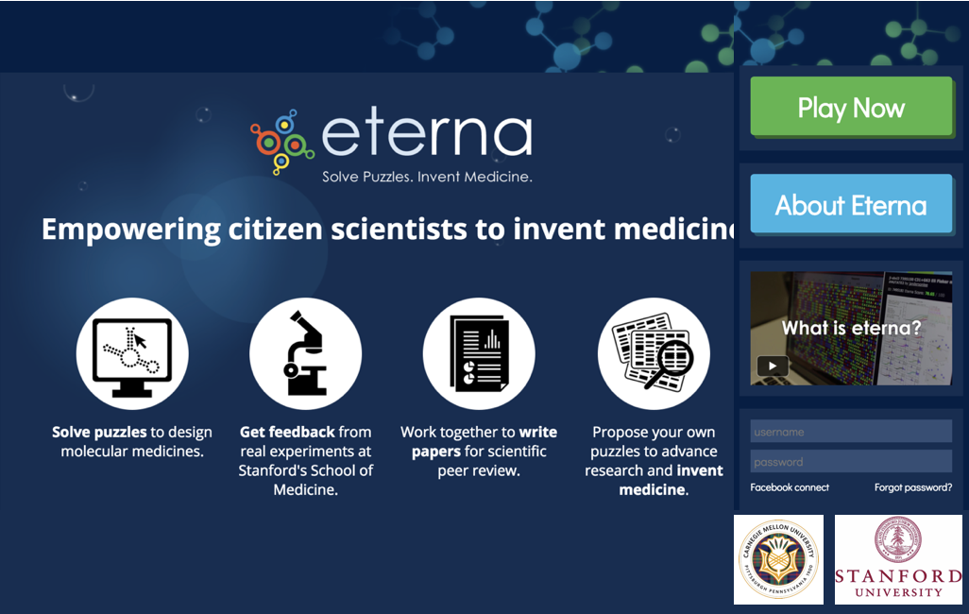

Slide 7
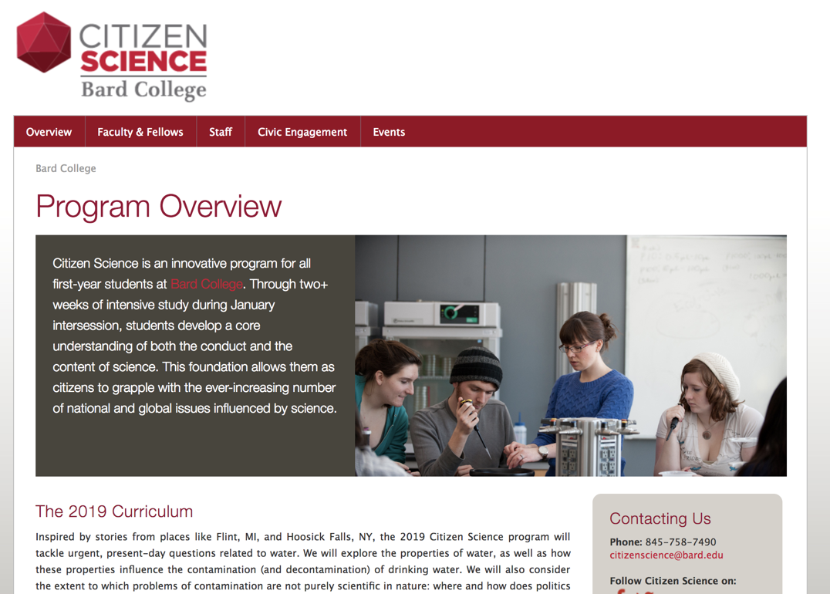

Slide 8
Zooniverse-based
Citizen Science & Research Experiences
in Science Classrooms

Slide 9

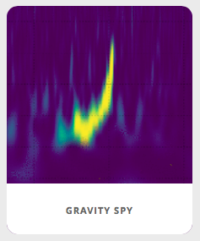
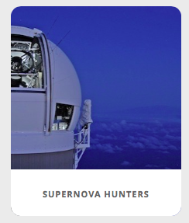
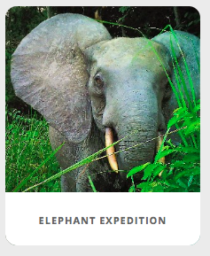

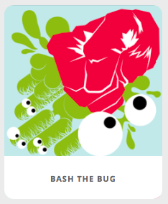
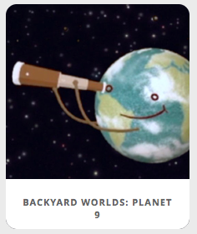
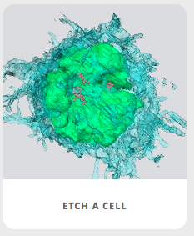
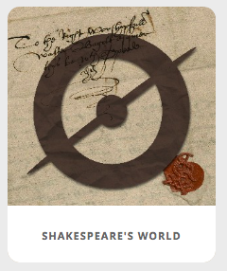
140+ projects across the disciplines 1.7 million people around the world
S I N C E 2 0 0 7
Astronomy | Ecology | Biomedical | Humanities

Slide 10
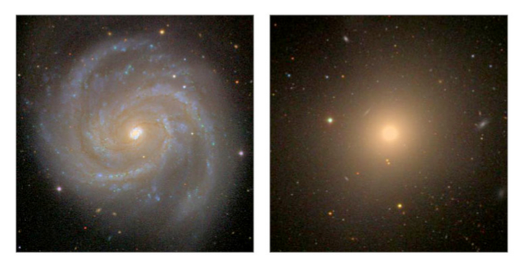
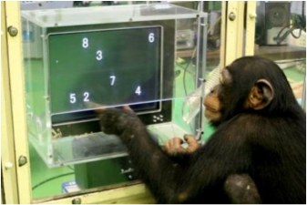

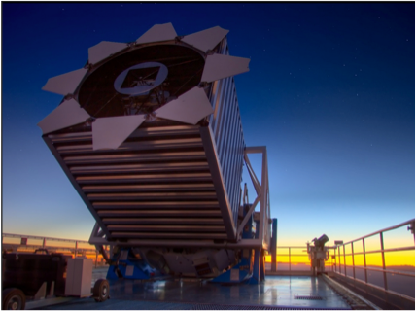
2007
Apache Point Observatory, NM
2007, Sloan Digital Sky Survey
Over 1 million galaxies

Slide 11
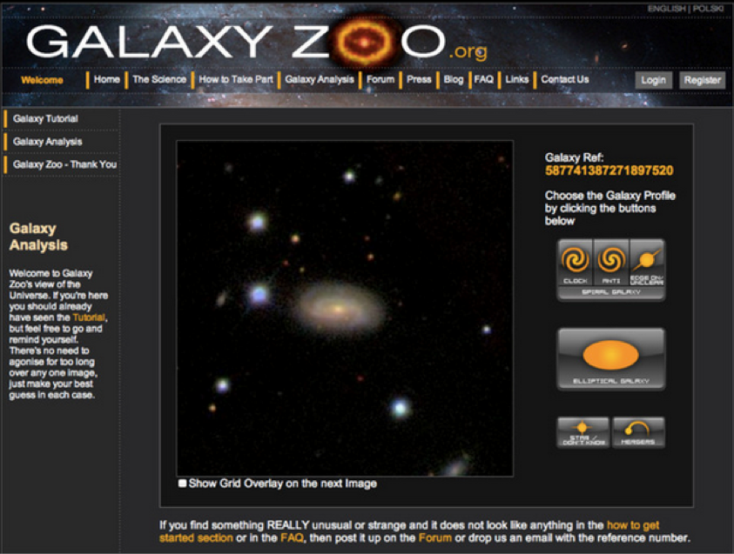
2007

Slide 12
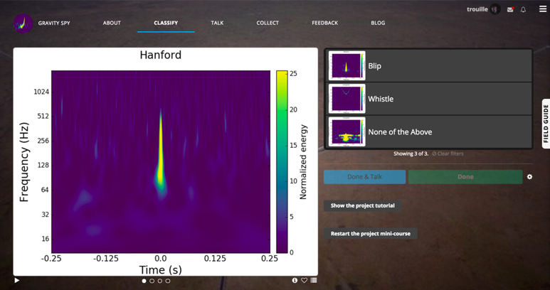

Gravity Spy

Slide 13
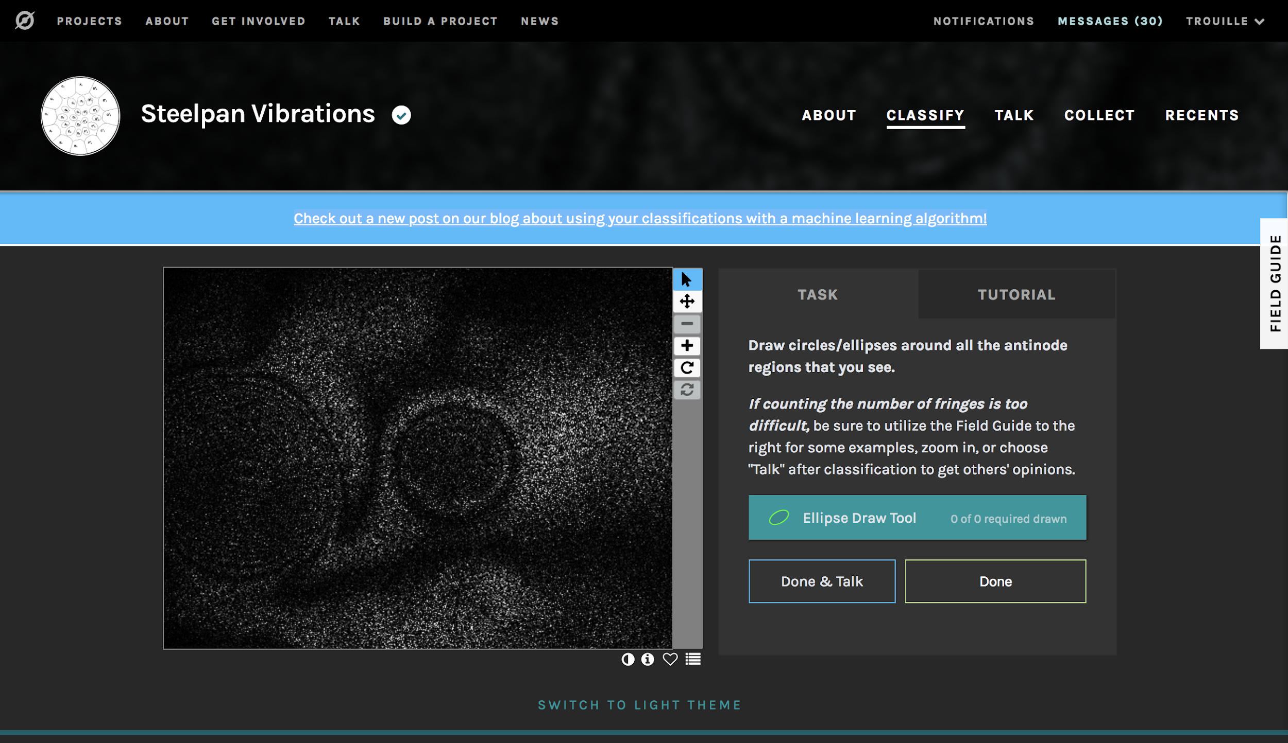

Slide 14
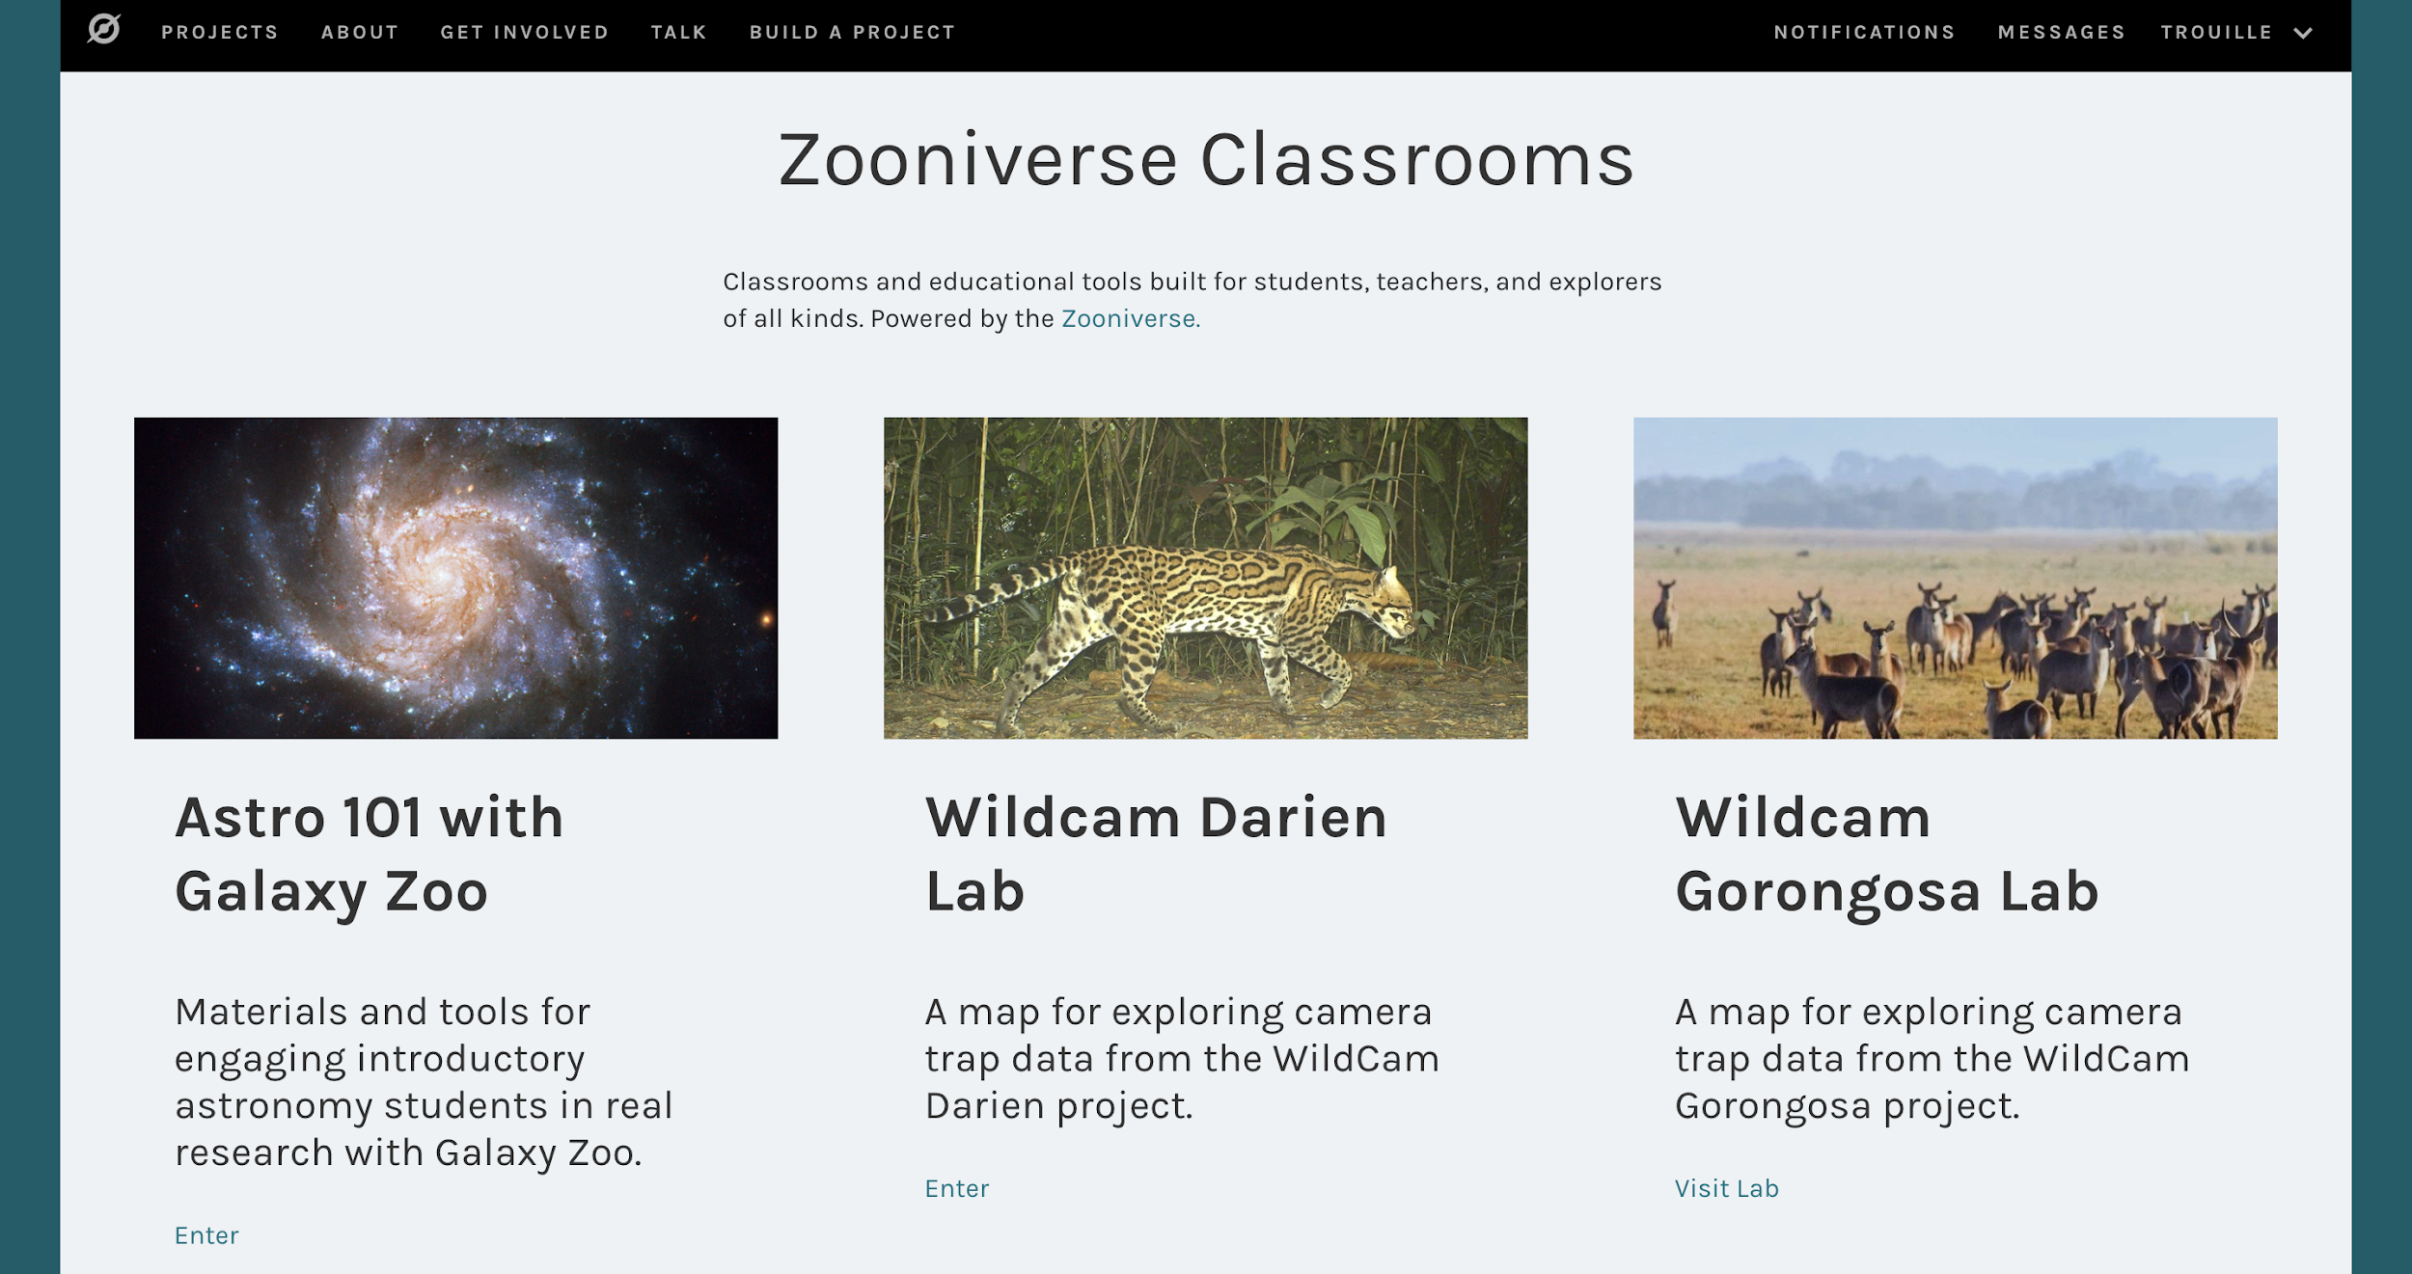


Slide 15
Engaging Introductory Astronomy Students
in Authentic Research through Citizen Science
Goals:
Contribute to real research through participation in citizen science
Improve understanding of process of science and data literacy
Provide a small group research experience using real data
Method:
4 in-class activities
Insight into data reliability through citizen science
Guided use of the data analysis tools
Out-of-class, small group research project

Slide 16
NSF Study: Participating Institutions
Institution | Course Structure | Timing | # of Students
Northwestern Univ. Private, R1 | Lecture, Quarters | Fall ‘16 + Fall ‘17 | 100+100
Univ. of Pittsburgh Public, R1 | Lecture+Lab, Semester | Spring ‘17 | 230
Univ. of Minnesota Public, R1 | Lecture, Semester | Spring ‘16 | 150*
Oakton Community College | Lab, Semester | Spring ‘17 | 25
Univ. of St. Thomas SLAC | Lecture, Semester | Spring ‘17 | 120
*Pilot tested materials but not formally part of the research study.

Slide 17
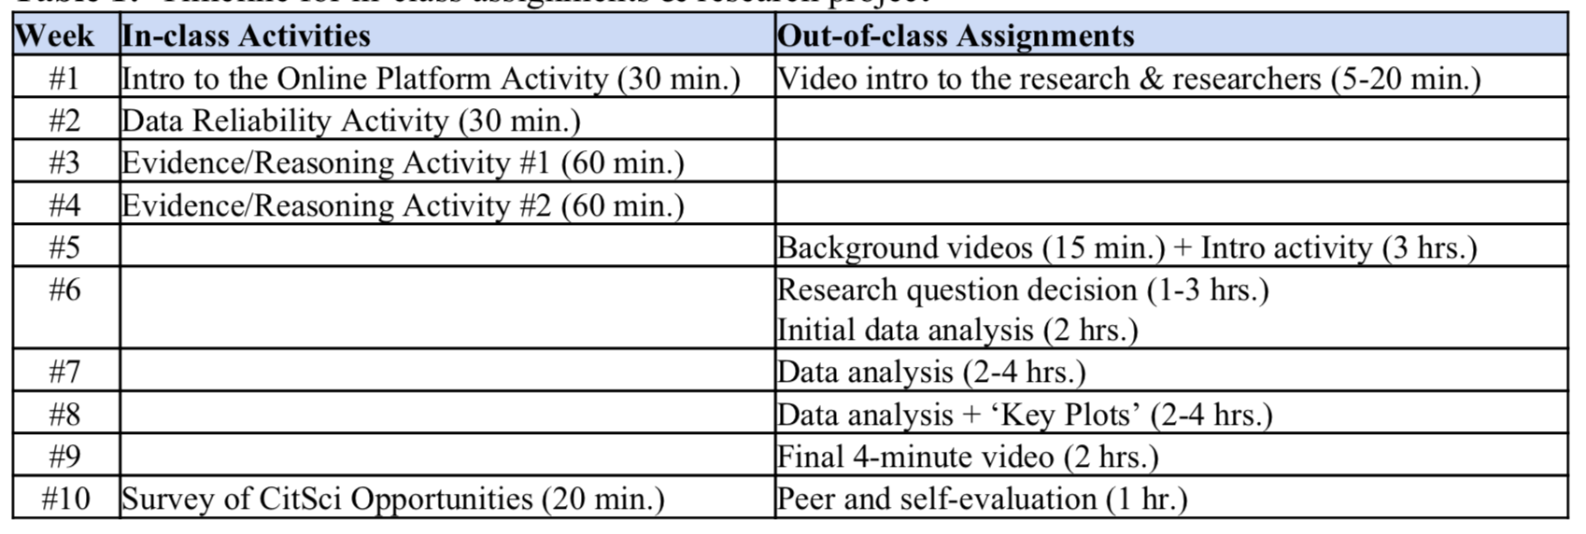
Timeline for In-Class Assignments & Research Project

Slide 18
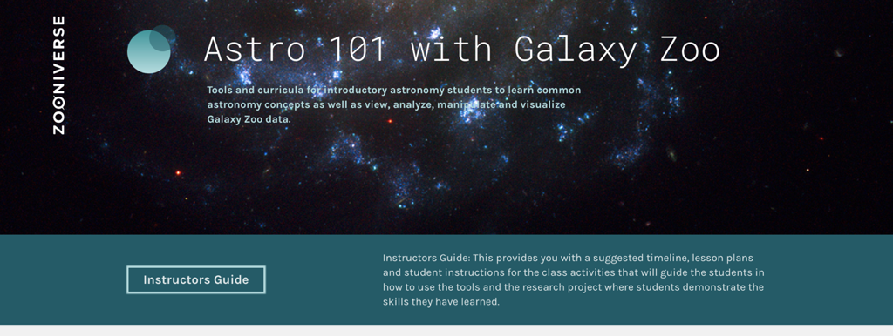
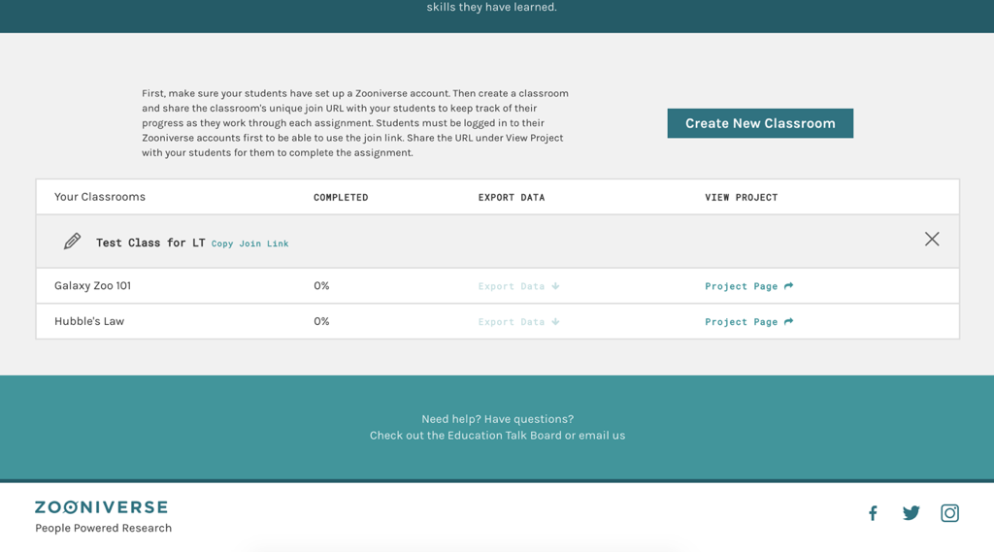

Slide 19
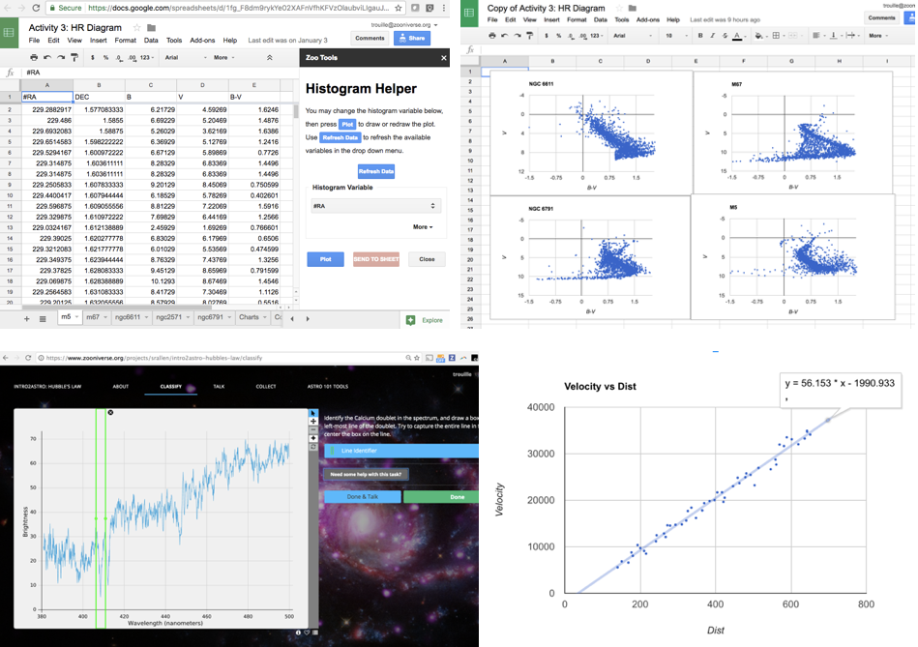
In-class
Activities:
Star Cluster
Aging
Hubble’s
Law

Slide 20
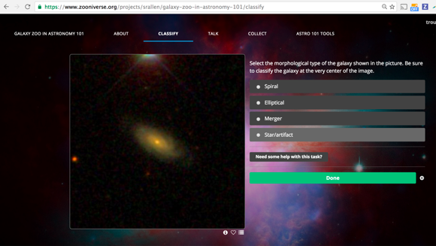
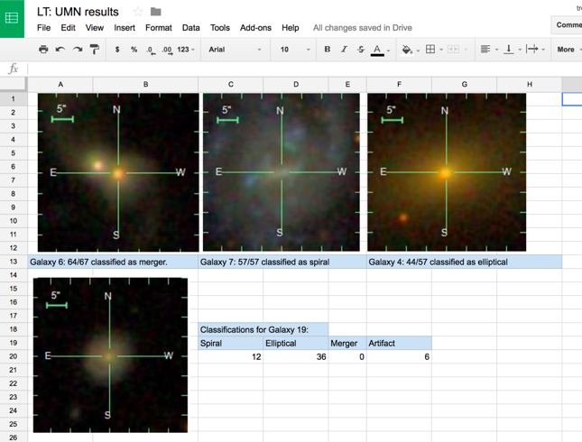
In-class
Activities (cont.):
Crowdsourcing
Consensus:
Data Reliability Activity

Slide 21
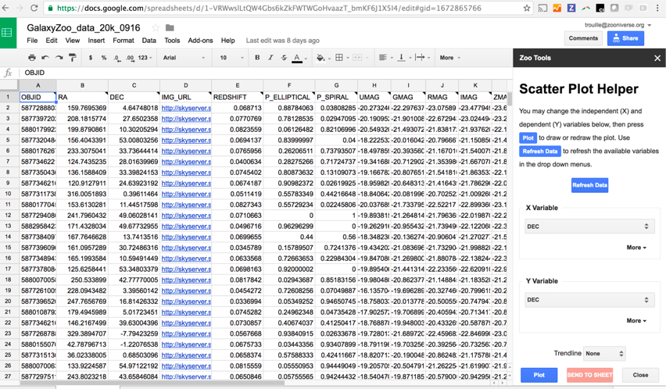
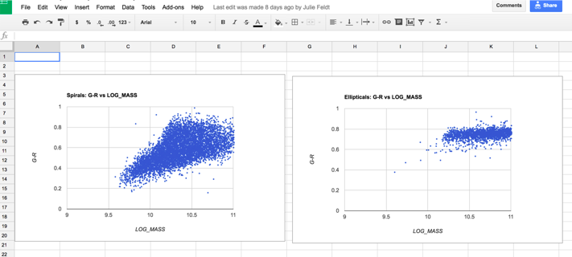
Small Group Research Experience

Slide 22
Small Group Research Experience
15-20 hours
Pinball process of science video reflection
Guided introductory research activity
Research question(s) + hypothes(es)
Key plots
4 minute video
Peer review

Slide 23
Impact
Exemple student quotes:
“ [Analyzing] the data taught us how easily scientific data can be manipulated and how important it is to know what data set was used and if any data was excluded in reaching a conclusion.”
“ Through conducting this research project, we found that the nature of science has deep roots in creativity. ”

Slide 24
Expanding Classroom.Zooniverse.Org
to Astronomy, Geoscience, and Biology

Slide 26
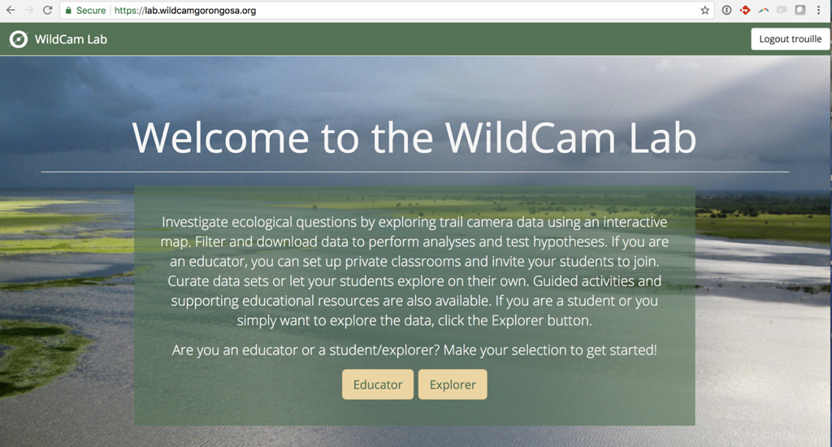

Slide 27
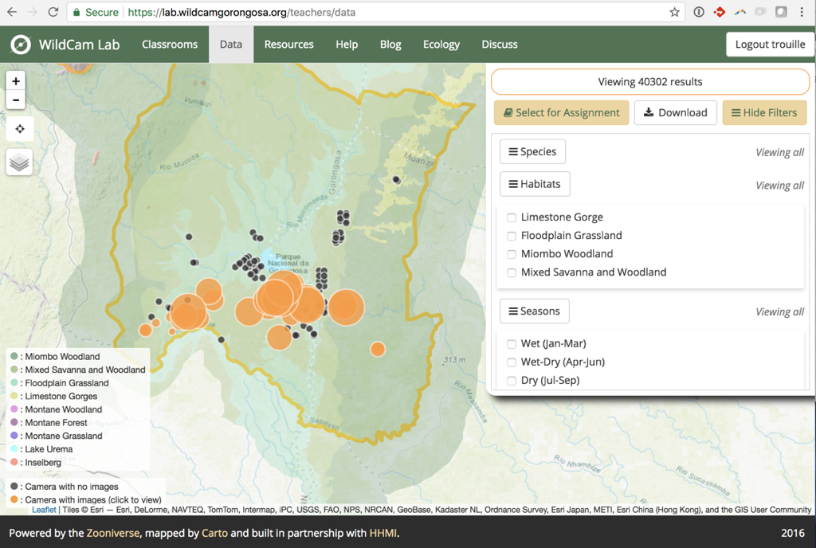
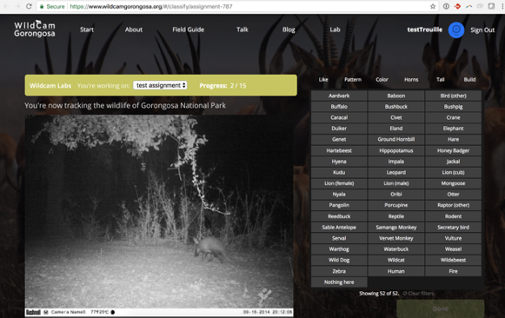

Slide 28
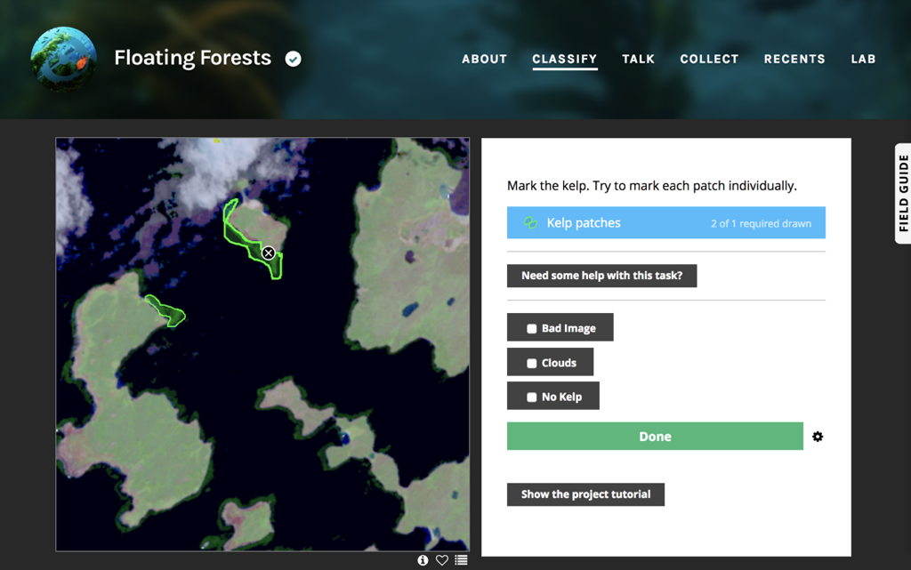

Slide 29
Design Principles
Low barrier to entry
Data analysis tools appropriate for audience
High threshold
Quality data feeding into broader effort

Slide 30
Democratizing Access to Research Tools

Slide 31
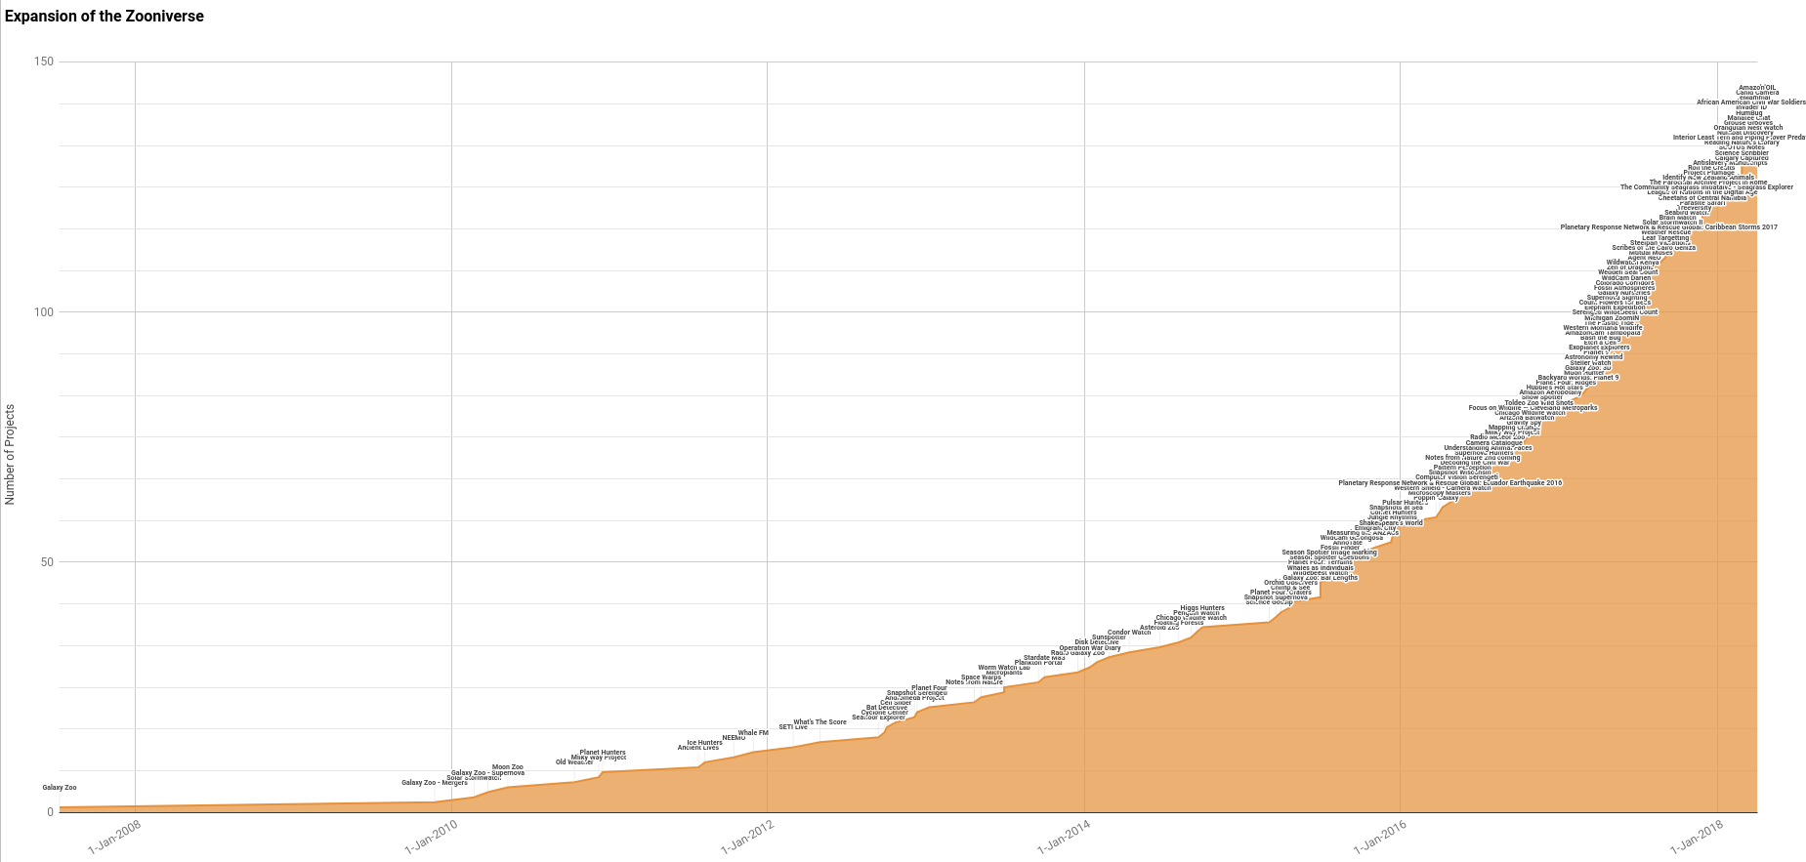
2015: Launch Free Project Builder Platform
Number of Projects
Time

Slide 32
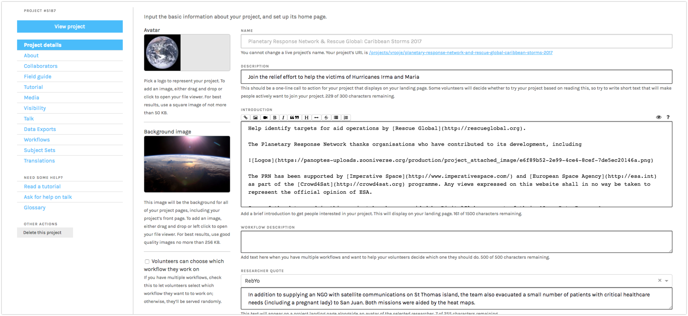
Project builder interface https://www.zooniverse.org/lab

Slide 33
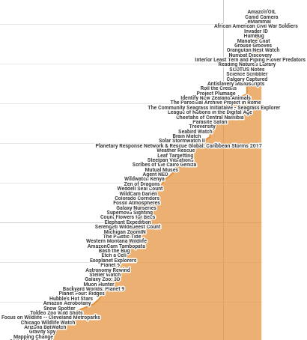
80+ new projects launched in the last 18 months
~1 per week

Slide 34
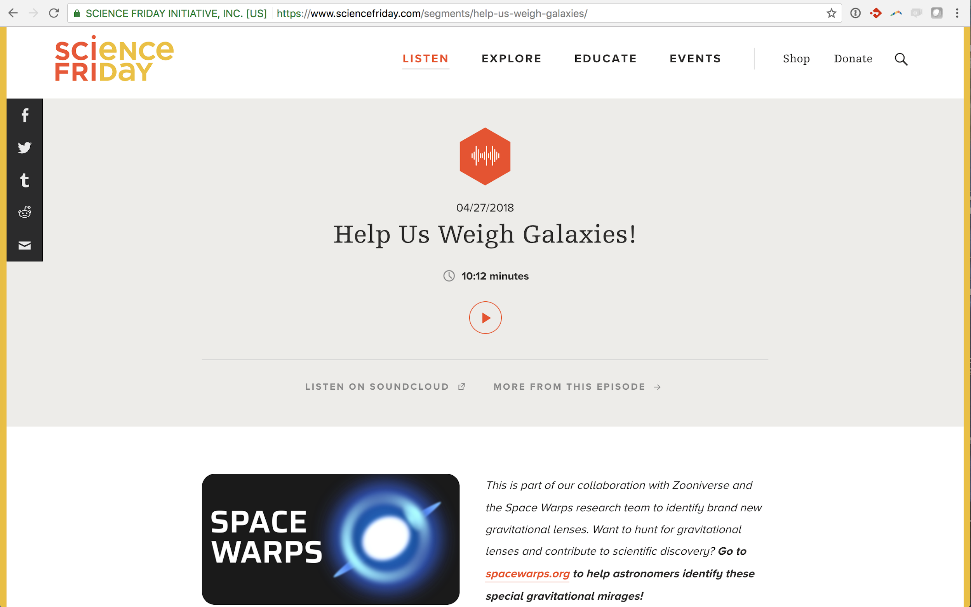
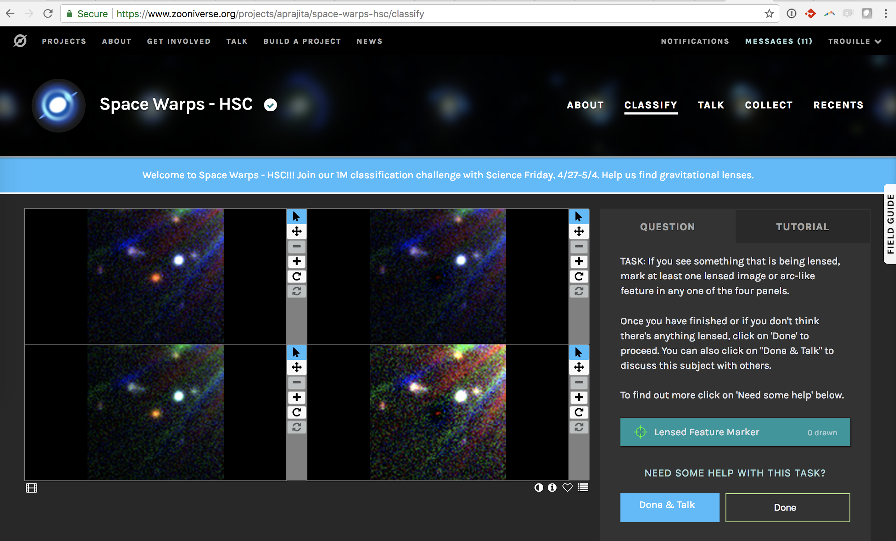
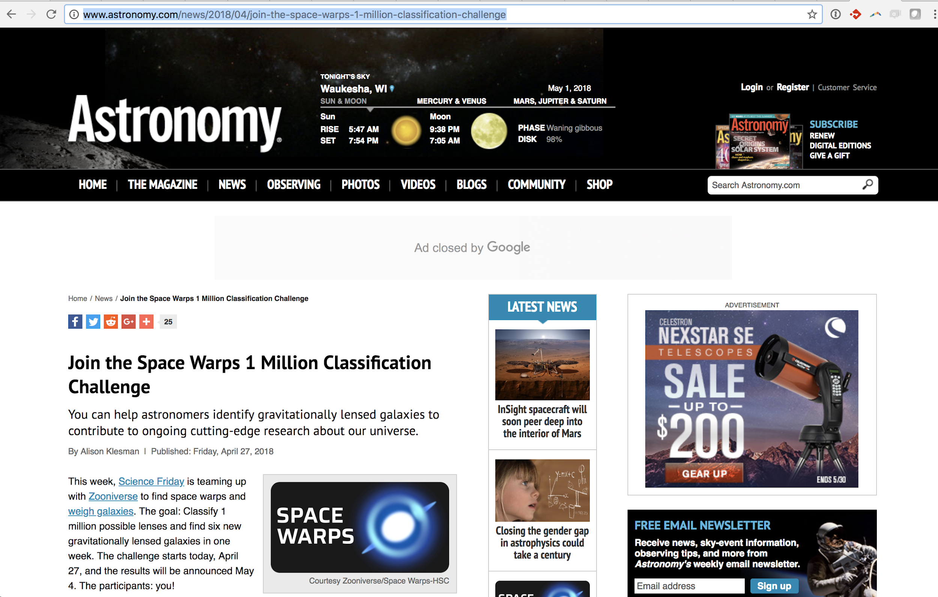
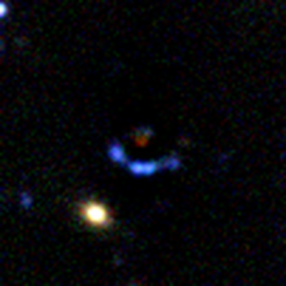
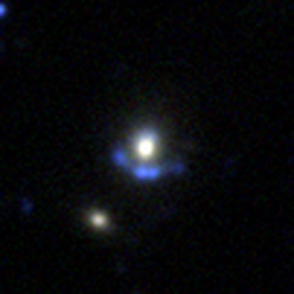
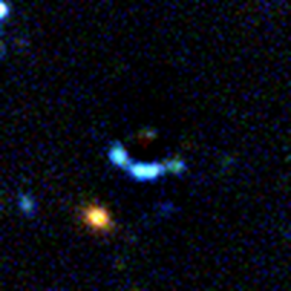
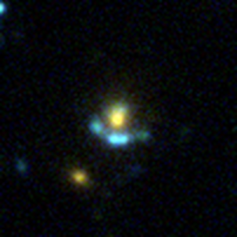
3500+ volunteers; 77,000 images

Slide 35
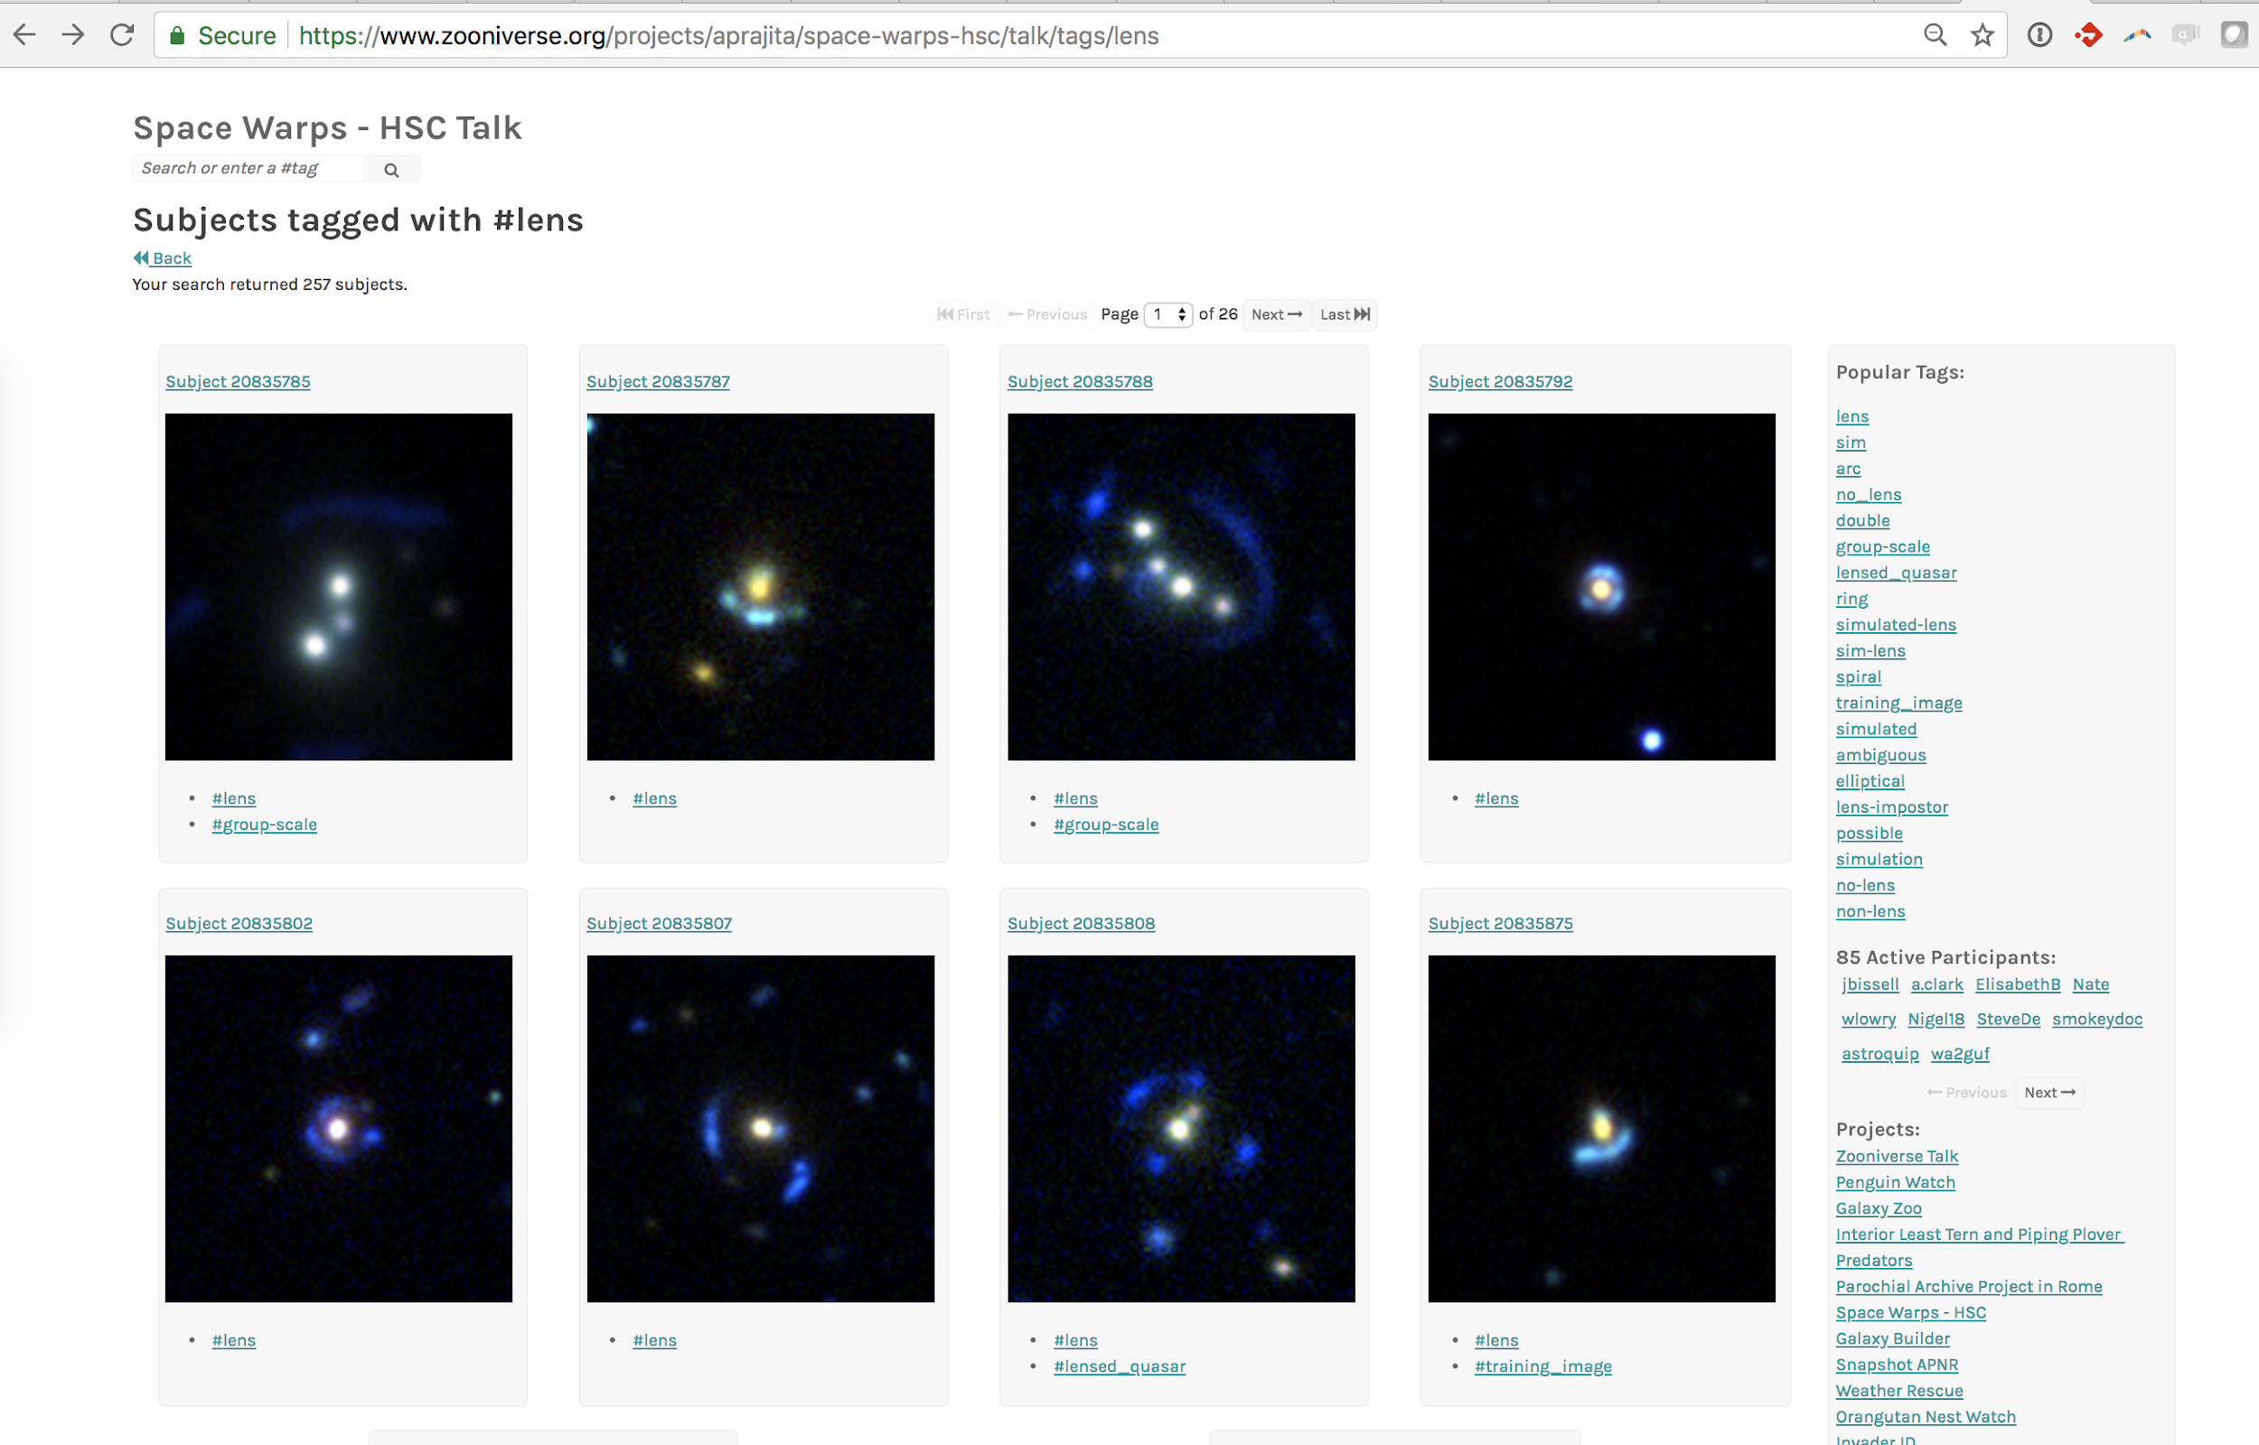
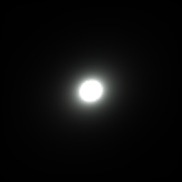
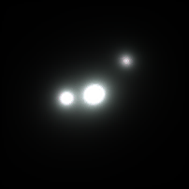
Image caption, citation, etc.

Slide 36
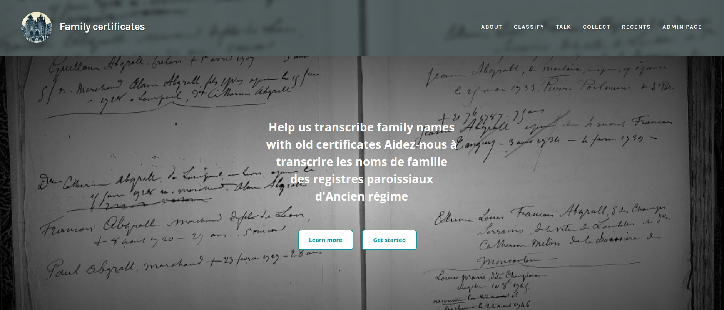
24 volunteers; 6000 pages

Slide 37



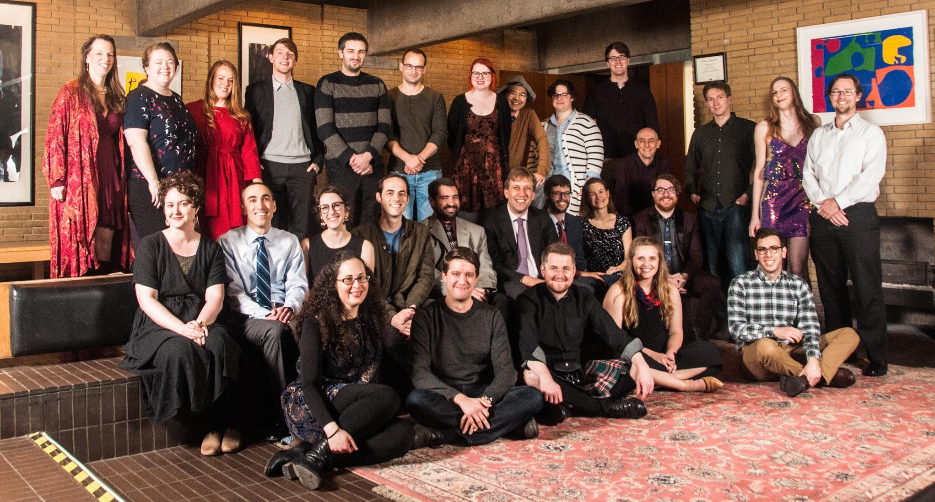
Thanks to the Zooniverse Team!
Funding from:
NSF, NASA, NOAA, IMLS, Google, The Alfred P. Sloan Foundation,
The Helmsley Foundation, The Leverhulme Trust, European Union FP7, SDSS, TED, Microsoft
Notes:
Team

