Slide 1
Space Insurance: The New Frontier
By Ryan Cox

Slide 2
What is an actuary?
Business professional that analyzes statistics to:
Manage financial risk
Develop and maintain insurance products
Determine the likelihood of future events with numerical analysis
Mitigate the effect of adverse events

Slide 3
Satellite Insurance
Covers three risks:
Relaunching the satellite if it fails on the initial launch.
Replacement if satellite is destroyed, placed in an improper orbit, or fails during orbit.
Liability protection in case satellite or launch equipment damages third party property.

Slide 4
Satellite Collision Coverage
In 2009, an inactive Russian military satellite collided with an Iridium satellite.
600 pieces greater than the size of tennis balls hurtled at about 5 miles per second.
Rapid moving debris poses huge threat to geosynchronous satellites.
Most commercial insured satellites orbit about 22,400 miles above Earth.
Collision took place at an orbit much closer to Earth, where most government and research satellites orbit uninsured.
Likelihood of collisions is small now, but will increase with demand from industries like shipping, mining, and web sites.
Potential untapped market.

Slide 5
Space Travel Insurance
Allianz will offer space travel policies for space tourism ventures.
This coincides with Virgin Galactic’s plans to offer sub-orbital spaceflights.
Premiums range from $700 to $10,000.
Covers cancellation of a trip.
Since NASA has retired shuttle program, it plans to hire firms like Virgin Galactic to send astronauts into space.

Slide 6
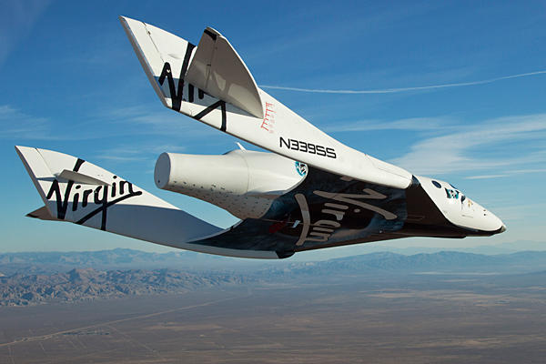
VSS Enterprise

Slide 7
Space Weather
Powerful solar storms could negatively affect our electronic infrastructure.
Potential to damage satellites and power grids.
Untapped market for space weather insurance.
On Sep. 2, 1859, a solar storm overloaded telegraph lines globally, which caused fire outbreaks at telegraph stations and communication failure.
If a similar event were to occur today, the effects on our telecommunications would be devastating with costs over $1 trillion.

Slide 8
References
Allianz. Space Weather Insurance. <http://www.agcs.allianz.com/insights/expert-risk-articles/space-weather-risk/#>.
Jones, Marc. German Firm Starts Selling Space Insuracne. <http://uk.reuters.com/article/2011/11/16/oukoe-uk-germany-space-insurance-idUKTRE7AF2EV20111116>.
Mott, William H.; Sheldon, Robert B. (2000). Laser Satellite Communication: The Third Generation. Praeger. pp. 142.
Ram, Vidya. Space: Insurance’s New Frontier. <http://www.forbes.com/2009/02/13/space-insurance-collision-face-markets-0212_space_22.html>.
VSS Enterprise. <http://www.csmonitor.com/var/ezflow_site/storage/images/media/images/1011-virgin-galactic-enterprise/8785654-1-eng-US/1011-Virgin-Galactic-Enterprise_full_600.jpg>.

