Slide 1
The Evolution of a Star
An Interpretive Musical Composition for Tenor Saxophone
by Kyle Cartwright

Slide 2
Gas Cloud
We start our journey in the evolution of our star as a gas cloud that over millions of years has slowly gravitationally pulled in on itself getting denser and denser. We begin to see the first evidence of star formation. Our star is now a protostar.
(Gas cloud is represented by sparsely placed notes slowly getting more frequent)

Slide 3
Main-Sequence Star
Our star can now fuse hydrogen into helium in its core and is now a main-sequence star. Our star will remain on the main-sequence for most of its multi-billion year lifetime. But for the sake of this project we will move on disproportionally through the life of the star in the music.
(Represented by a large build to a high pitched hum.)

Slide 4
Red Giant Phase
Our star is running out of hydrogen fuel and it expands forming a red giant star with a helium ash core. The red giant is still fusing Hydrogen into helium in a shell just outside the core.
(Represented by a descending line to a low pitched hum)

Slide 5
Yellow Giant Phase
Our red giant’s core is continually compacting, getting hotter and hotter until it undergoes a Helium Flash when it reaches 100 million degrees Kelvin. The core is now hot enough to fuse Helium into carbon in its core whilst still fusing Hydrogen into Helium in a shell outside the core. All the while our star is moving back toward the main sequence but is halted on the Horizontal Branch .
(Represented by a slight rise to a medium pitched hum)

Slide 6
Red Giant #2 Phase
Our star once again runs out of fuel in the core expanding its outer layers once again into an even bigger star than before leaving a Carbon ash core that is slowly compacting just as the Helium ash core did in our original red giant phase.
(Represented by the lowest note possible humming at a low volume)

Slide 7
Planetary Nebula
The core of our star has now compacted so much that the radiation pressure bursts the outer layers of material off into space in a catastrophic event leaving a giant planetary nebula. This is essentially a giant cloud of gas and material from the star.
(Represented by the low hum becoming somewhat unstable and chaotically rising to very high pitch and an explosive honk to represent the explosion of the material off the star)

Slide 8
White Dwarf
As we begin to view deep into the planetary nebula we see that the explosion left behind what is called white dwarf. This is the core that is left over from our Red Giant. It is mainly composed of very densely compacted carbon.
*Other options that it could have left behind would be a black hole or a neutron pulsar star had our star undergone supernova.
(Represented by another very high pitched hum that ends with a simple tag to resolve the piece)

Slide 9
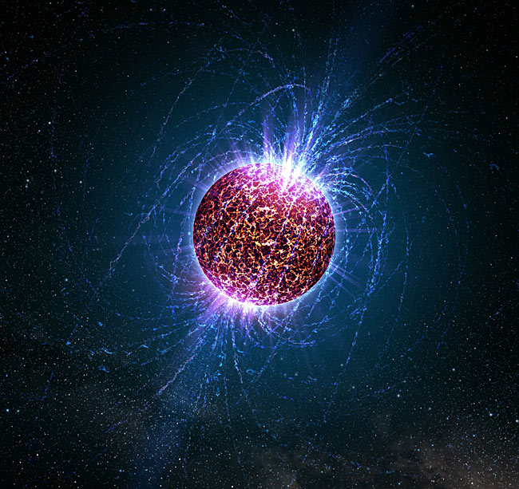
(Alternates) Black Hole Neutron Star

