Slide 1
Little Zoldar
and the
Phases of the Moon
A children’s book by Ian Sacks

Slide 2
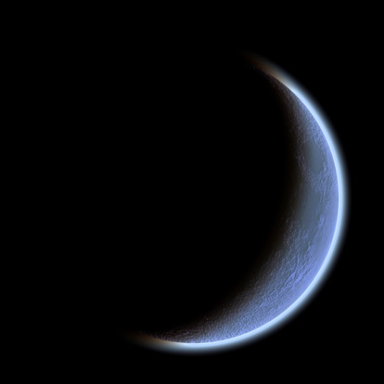
A Brief Summary
Young alien Zoldar and his father travel to Earth, where Zoldar learns the causes and names of the phases of its moon.
Complete with hand drawn art from writer Ian Sacks

Slide 3

Statement of Purpose
“Aimed at children between second and third grade, Zoldar aims to mix storytelling, humor, science content, and activities into a tool which communicates the true methods by which phases of the moon occur.”
- Author Ian Sacks

Slide 4
Correct Use of the Book
Phases of the moon and their causes are difficult to conceptualize and memorize, especially at the target age level. The concepts are meant to be mastered through repeated readings, and through attempting the included activities.
Several pages invite readers to make educated guesses at scientific diagrams. This is encouraged.
As the child develops a love for the characters, his or her interest in the scientific content will increase.

Slide 5
Why?
Phases of the moon are among the most misunderstood topics in astronomy today.
Many people believe they are caused by phenomenon such as the Earth casting a shadow at the moon.
Zoldar intends to dispel such misinformation at an early age.

Slide 6

About the Author
Ian Sacks was born in the humble state of Minnesota, where he taught himself to read. Books, that is.
At an early age, he happened to harbor a lifelong interest in writing, drawing, aliens, and phases of the moon.

